Slide 1
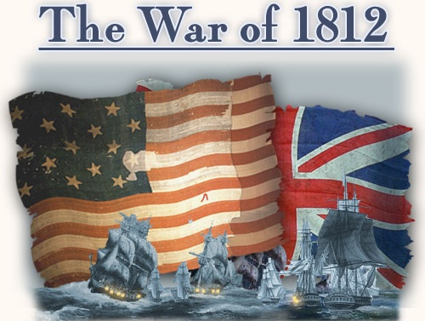

Slide 2
American Trade with France
Britain was heavily engaged in a war against France, and used its navy to block American merchants from trading with the French
Violation of American sovereignty

Slide 3
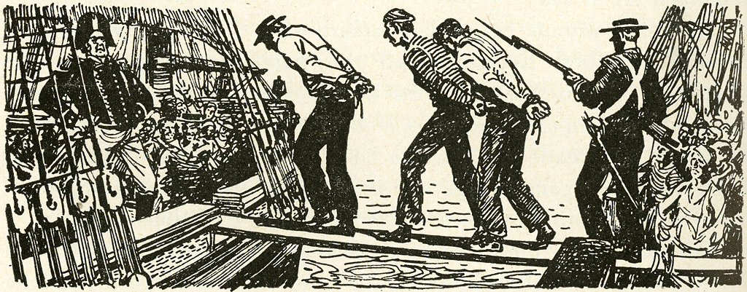
Impressment
Britain needed more sailors to man its navy
The British would stop American ships and seize any sailors they suspected of being British citizens

Slide 4
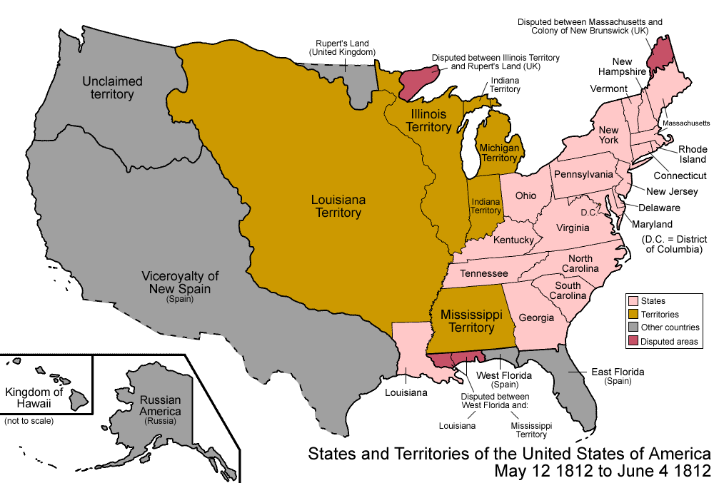
Support for Indians

Slide 5
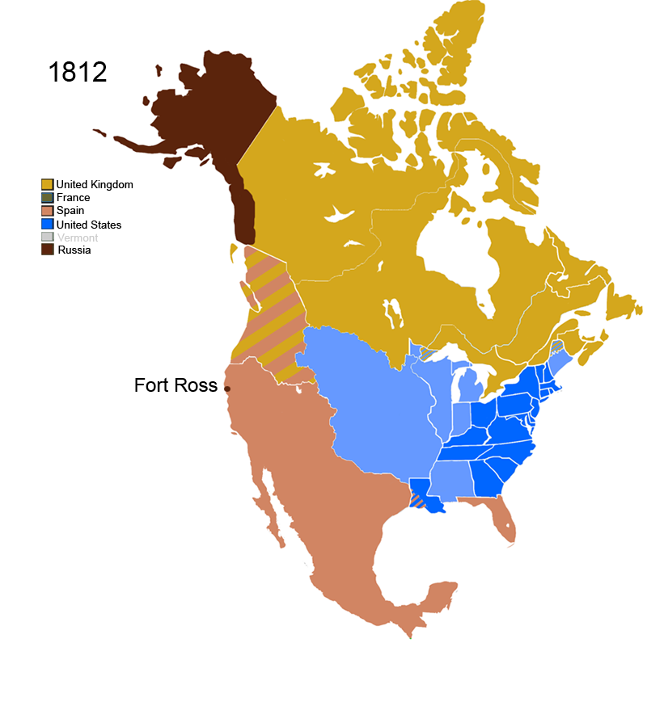
Canada
Americans coveted Canadian territory
Did they?
Britain could not afford to lose Canada

Slide 6
Perception of Victory
Americans saw this war as a second war of independence
Public opinion split regionally

Slide 7
Repayment for Slaves
The British freed any slave who made it to their battle lines.
American slave-owners were outraged
~ 3000 slaves escaped this way

Slide 8
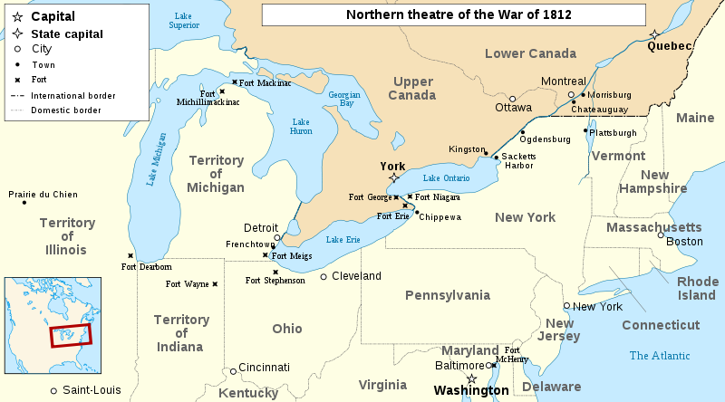
The War – Phase One
Canada
American forces were
poorly trained and led
Privateering

Slide 9
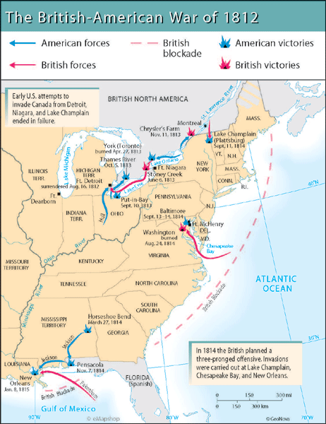
The War – Phase Two
Three major British invasion forces
Naval struggle in the Great Lakes

Slide 10
Adjusted Winner - Valuations
Item | USA | Britain
American trade with France | 20 | 30
Impressment | 25 | 15
Support for Indians | 20 | 15
Canada | 10 | 30
Perception of victory | 15 | 5
Repayment for slaves | 10 | 5

Slide 11
Adjusted Winner - Initial Results
US | Britain
Impressment (25) | American trade with France (30)
Support for Indians (20) | Canada (30)
Perception of victory (15)
Repayment for slaves (10)
Total: 70 | Total: 60

Slide 12
Adjusted Winner – Final Results
US, Britain split repayment for slaves 50:50
US | Britain
Impressment (25) | American trade with France (30)
Support for Indians (20) | Canada (30)
Perception of victory (15) | .5 * Repayment for slaves (10) = 5
.5 * Repayment for slaves (10) = 5
Total: 65 | Total: 65

Slide 13
Actual Results
US receives everything except for Canada
Boundaries return to pre-war state
Why?

